Slide 1


DEPARTMENT OF COMPUTER SCIENCE & ENGINEERING
SCHOOL OF COMPUTING
10214CS601 MINOR PROJECT -1
SUMMER SEMESTER(2024-2025)
REVIEW-1
“CLASSIFYING DIFFERENT TYPES OF PADDY DISEASES USING DEEP LEARNING”
SUPERVISED BY
PRESENTED BY
Dr.S.AMUTHA.ME.PhD
Professor
1.B.YUVARAJREDDY (25882)(23UECS0687)
2T.TARUN VENKATA SIVA (25653)(23UECS1218)
3.T.NAVEEN (26542)(23UECS0899)

Slide 2
OVERVIEW
ABSTRACT
OBJECTIVES
TIMELINE OF THE PROJECT
INTRODUCTION
LITERATURE REVIEW
DESIGN AND METHODOLOGIES
IMPLEMENTATION
CONCLUSION
REFERENCES

Slide 3
ABSTRACT
Purpose: The primary purpose of this study is to develop and evaluate a deep learning model for the classification of paddy diseases.Implement a deep learning model and Evaluate the model’s performance.
Method: Data Collection, Data Preprocessing, Model Development, Evaluation, Deployment.
Result: The deep learning model was trained on a diverse dataset of paddy images and achieved notable results in classifying various diseases.Key findings include:Accuracy, Precision and Recall.
Conclusion: The model’s high accuracy and reliable performance suggest that deep learning can be a valuable tool for automating disease detection in agriculture. Integrating such technology into agricultural practices can enhance early disease detection, improve yield management, and support sustainable farming practices.

Slide 4
OBJECTIVES
Aim of the project:This project’s primary goal is to develop a deep learning model for the detection and classification of paddy crop diseases using transfer learning and image processing, with all of the work being done in deep learning.
Scope of the project: The project’s goal is to help increase yields by preventing crop devastation. Many farmers wish to accept advanced agriculture, but many are unable to do so for a variety of reasons, including lack of knowledge about cutting-edge technology and significant technical costs. It has frequently been noted that paddy diseases are challenging to manage because their prevalence varies depending on the environment.

Slide 5
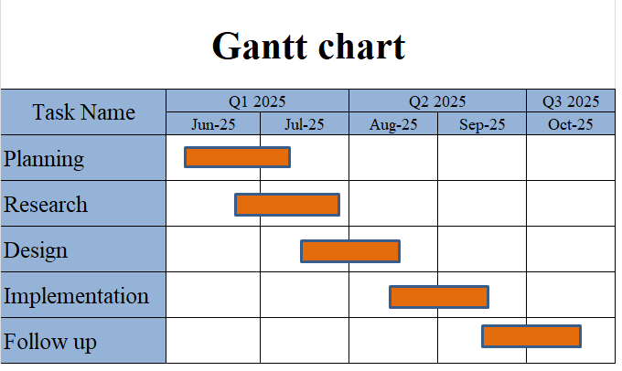
TIMELINE OF THE PROJECT
TIMELINE OF THE PROJECT
Sample Gantt Chart
October 16,2025

Slide 6
INTRODUCTION
One of the most important agricultural procedures is the classification and identification of paddy plant diseases at an early stage.
Genetic disorder infection causes farmers to lose a lot of money every year. Consequently, a prompt, accurate, and early identification of the illness both reduces product loss and raises product quality.As a result, it contributes to the growth of the nation’s economy.
In conventional medical procedures, the diagnosis of these diseases is based either on the pathogens visible symptoms or on pathogen identification in a lab.
The visual evaluation of the disease area is a subjective matter that may not provide a reliable diagnosis.
On the other hand, pathogen growing takes time and can fail to produce results when needed, making pathogen identification in a lab a laborious operation. We looked at pictures of several plant diseases.

Slide 7
LITERATURE REVIEW
Author’s Name | Paper name and publication details | Year of publication | Main content of the paper
Houda Orchi | IEEE Papers | 2023 | Automation of crop disease detection through CNN
Vinay Gautam | IEEE Papers | 2022 | Disease detection in rice leaves using transfer learning

Slide 8
Alice Brown, Michael Lee | IEEE Papers | 2020 | transfer learning techniques
V Malathi | IEEE Papers | 2021 | Classification of pest detection in paddy crop based on transfer learning model

Slide 9
DESIGN AND METHODOLOGIES
MODULE 1: Collection of data
MODULE 2: Processing of data
MODULE 3: Algorithm

Slide 10
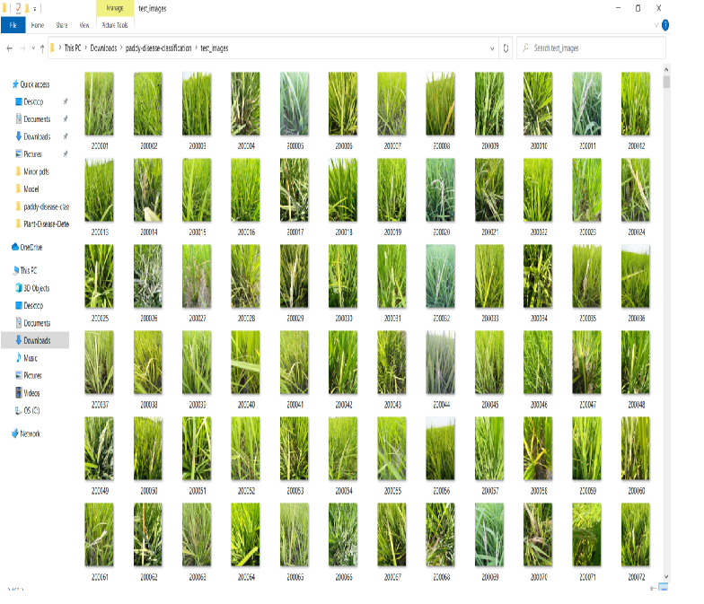
MODULE 1:
Step:1 Collection of data

Slide 11
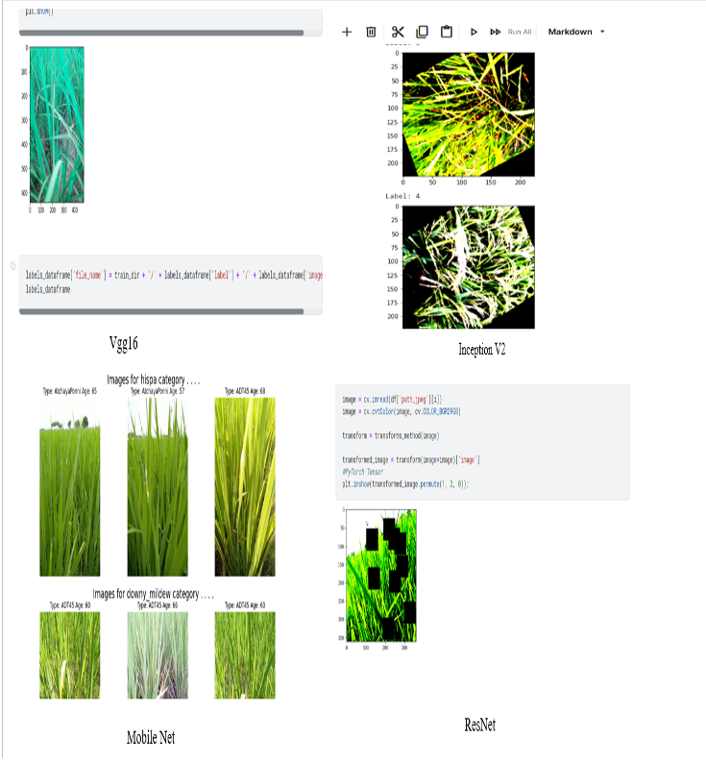
Step 2: Processing the data

Slide 12
Module 2- Mention the algorithm
Step1 : Start
Step2 : As we are using the CNN models we have to choose a dataset first, prepare the dataset for training.
Step3 : Create the training data and assign features and labels ,normalize and convert 16 labels into categorical data.
Step4 : Split x and y for using in CNN models.
Step5 : Give the directories of train and validation datasets for the training model.
Step6 : Save the model for testing.
Step7 : Test the model using the test dataset
Step8 : It gives the output as affected disease name.
Step9 : Stop

Slide 13
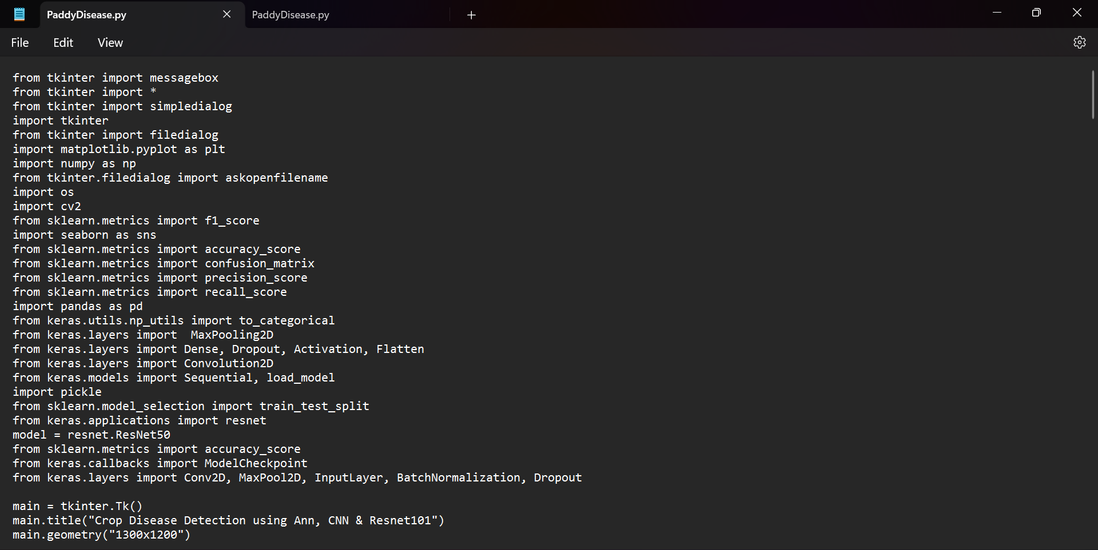
Step 3: Using algorithm’s name algorithm

Slide 14
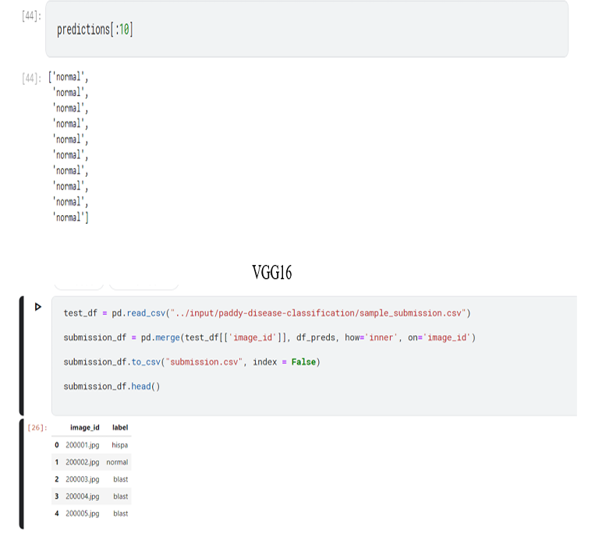
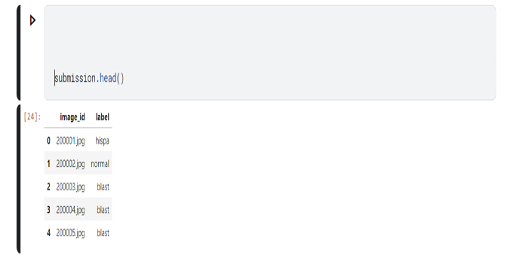
Step 4: The output

Slide 15
IMPLEMENTATION
Architecture Diagram
Data –Flow Diagram
Use Case Diagram
Class Diagram
Activity Diagram
Sequence Diagram
Collaboration Diagram(If applicable)
E-R Diagram

Slide 16
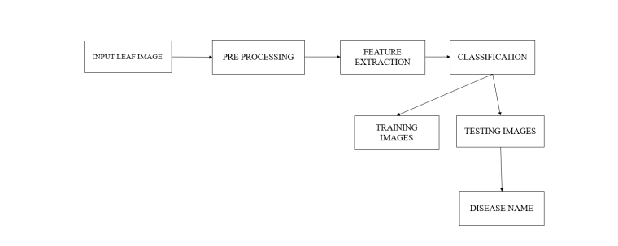
Architecture Diagram

Slide 17
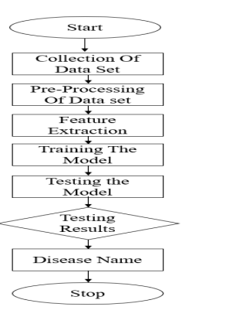
Data –Flow Diagram

Slide 18
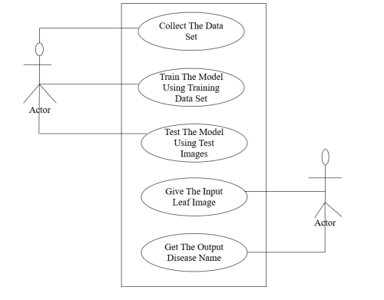
Use Case Diagram

Slide 19
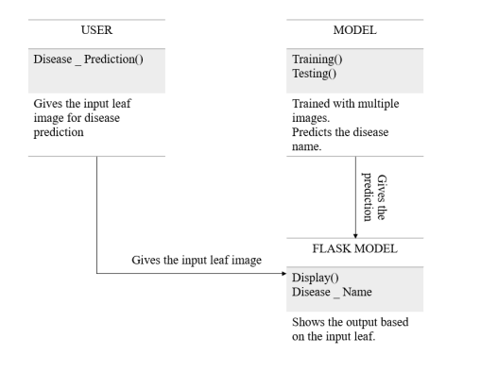
Class Diagram

Slide 20
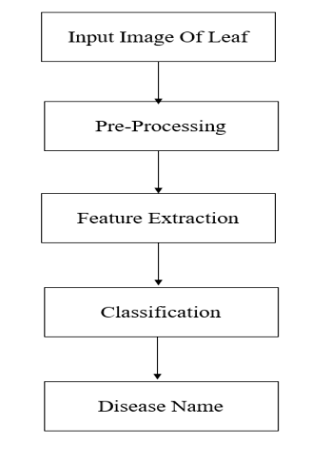
Activity Diagram

Slide 21
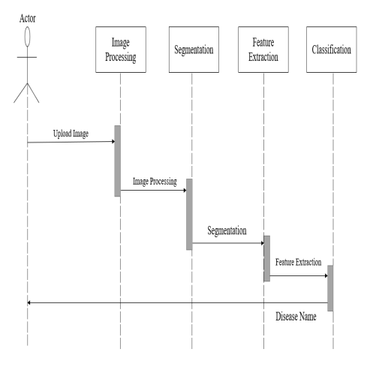
Sequence Diagram

Slide 22
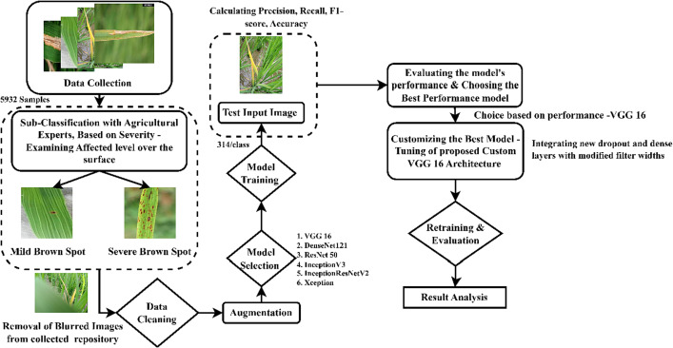
E-R Diagram

Slide 23
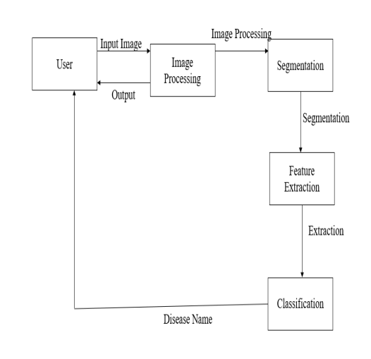
Collaboration Diagram

Slide 24
REFERENCES
Houda Orchi et al.,”Automation of Crop Disease Detection through Conven_x0002_tional Machine Learning and Deep Transfer Learning Approaches ”.,vol.13(2),pp.352,2023.
Ahmed Samit Hatem et al .,” A Transfer Learning-Based Artificial Intelligence Model for Leaf Disease Assessment”, Vol. 29, No. 2, pp. 1030-1038, February 2023.
Vinay Gautam et al .,“Disease detection in rice leaves using transfer learning techniques ”., vol.14(20), no.13610,2022.
Sunu Jatmika et al.,” Rice Plants Disease Identification Using Deep Learning with Convolutional Neural Network Method“.,Vol. 7, No 2, July 2022.
Andrew J et.al” Deep Learning-Based Leaf Disease Detection in Crops Using Images for Agricultural Applications “., vol.12, pp.2395,2022.

Slide 25
THANK YOU

